Slide 1
Strategies to Help individuals with ASD Develop Independence and Adaptability
Meghan Barlow, Ph.D.
Pediatric Psychologist

Slide 2
Transition to adulthood
Obstacles to Overcome

Slide 3
Supports and interventions may actually be one of the biggest obstacles in the way of individuals developing independence. We should not routinely do for others what they can do for themselves. And, we should break tasks down and teach individual chunks of a task, allowing individuals to complete at least those small chunks on their own.

Slide 4
Start Transition Planning
In high school?
In elementary school?
In pre-school?
Early intervention?

Slide 5
Start Transition Planning
At diagnosis, with the first intervention
Remember to ZOOM

Slide 6
Priorities of Instruction for Transition
Suggested in Wehman, 1992 Life Beyond the Classroom
Student and family input (1 year, 5 year, 10 year)
Survey current and potential future environments based on the above desired outcomes
Assess skill needs in potential environments in terms of production, social, and navigation skills

Slide 7
Priorities of Instruction for Transition
Prioritize skills that occur across multiple environments
Attend to safety skills
Attend to skills that reduce dependence
Attend to skills NT cohorts will need to be taught

Slide 8
Gerhardt’s Shortcut
If you can teach the skill, teach it
If you can’t teach the skill, adapt it
If you can’t adapt it, figure out some way around it
If you can’t figure out some way around it, teach the NTs to deal with it

Slide 9
Ultimate Criteria
“If the student does not learn to do the task, will someone else have to do it for them?”
Lou Brown, 1985

Slide 10
Focus on Functionality
When developing treatment plans
Include the phrase “in order to ________”
Include a sibling or trusted NT peer
Or get feedback from a trusted NT peer

Slide 11
From Pediatrics to Adult

Slide 12
Transition Between Worlds
Varies from organization to organization/provider to provider
Do some research
Ask some questions
Speak up
Gain consent

Slide 13
Ease the Transition
Develop a handout/timeline
Include treatments, medications, set backs
Anticipate background questions
Suggest authorizing communication and have contact information ready

Slide 14
Self-Awareness and Self-Advocacy

Slide 15
Goals
Individuals recognize and understand how and why
Individuals recognize and understand what helps
Individuals can communicate to others their needs and desires
Individuals can structure their own environments to meet their needs and desires
Individuals ask for help when needed
Individuals use problem solving skills

Slide 16
How Do We Get There?
Involve individuals in goal planning as early as possible
Reinforce when individuals advocate for themselves
Take time to reflect on what is working, make note of it
Self-Monitoring
Teach a process (and focus less on outcome)
Scaffold and fade
Recognize “natural” supports
Technology

Slide 17
Advocacy (In All Forms)
“Non-compliance”
Resistance
Aggression/self-injury
Disruptive Behavior
Escape/Avoidance
Repetitive questioning
Changing topics

Slide 18
Areas of Advocacy
Personal safety
Leisure and recreation
Service, supports, and interventions
Social relationships
Romantic relationships
Legal and civil rights

Slide 19
Essential Skills

Slide 20
Motivation
Help individuals see who the work is for (ahem: not us)
Treatment planning
Social Behavior Maps
Teach motivation directly – what it is, why it’s hard to find, everyone struggles at times
What’s getting in the way?
Feeling overwhelmed
Wanting control?

Slide 21
Basic Concept Taught in SBM
Expected Behavior
+ thoughts and feelings about you
Good things
You Feel Good

Slide 22
Time Management
Predicting time
Passage of time
Sense of urgency – time limits and deadlines
Contingency planning

Slide 23
Technology

Slide 24
“Bug in the Ear”
Teach and practice a skill
Use Bluetooth and fade proximity to therapist/instructor
Allows for practice with layers of complexity

Slide 25
In their Pocket
Reminders, prompts
Apps
Schedules
Notes
Relaxation/regulation
SOS texts

Slide 26
360 Thinking Time Tracker App

Slide 27
On The Road

Slide 28
Resistance to Driving
What is scary about it?
Unexpected situations
Responsibility, Control
Increased levels of complexity
Dynamic, fast paced situations

Slide 29
Lots of Practice
Time
Place
Person
Master then move on

Slide 30
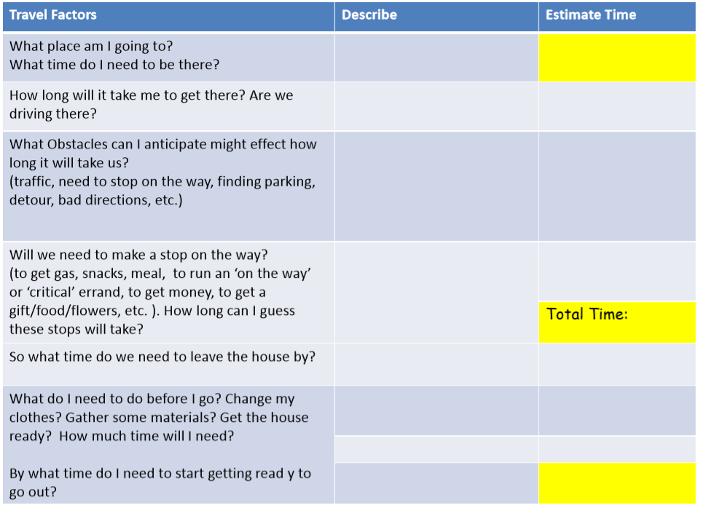
Driving Time
Time management pops up here, too!
Being late to work can get you fired
Being late to appointments, meetings, social events are problems, too
- Taken from www.efpractice.com Sarah Ward, MS CCC-SLP

Slide 31
Anticipate
Car trouble
Trouble with other drivers
Roadblocks
Weather conditions
Getting pulled over

Slide 32
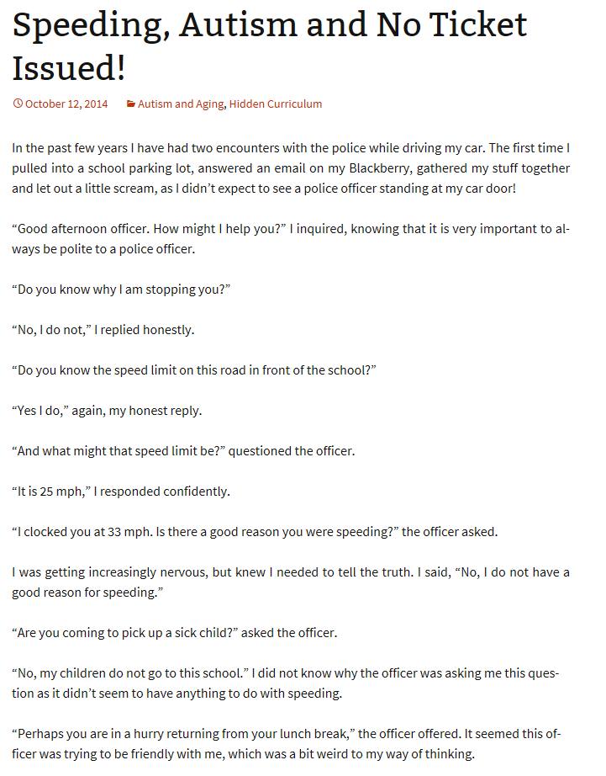

Slide 33
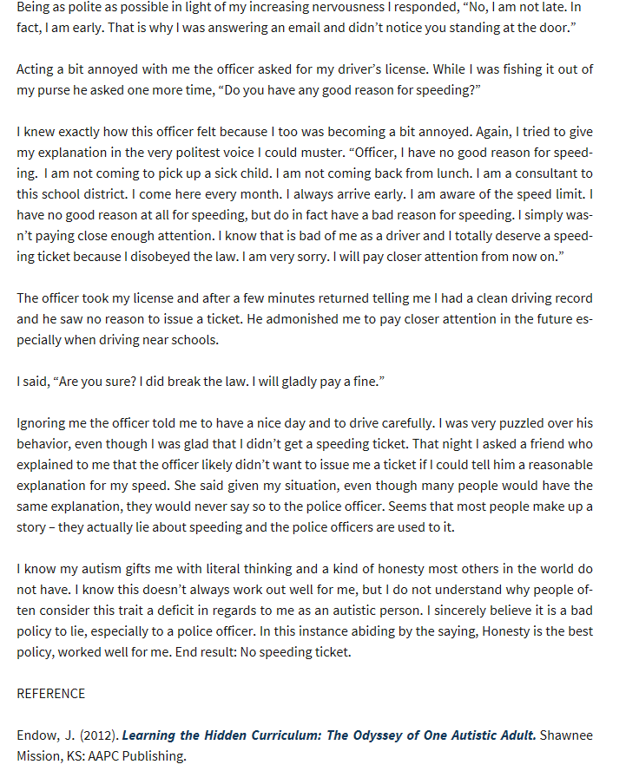

Slide 34
In The Dorm

Slide 35
Perspective Taking
Recognize others’ thoughts and feelings
Adapt behavior if necessary
Open the door for being direct
Recognize your rights and be able to advocate
Communicate your requests

Slide 36
General Guidelines to Follow
Do not use, borrow, or take any of your roommate’s belongings without permission
Do not sit or lay on your roommate’s bed
Even though it’s your bedroom, you can not masturbate or have sex with your roommate in the room
If your roommate is sleeping (day or night), be as quiet as you can when you come in and get your things
If something routinely annoys you, consult with someone and make a plan

Slide 37
Keep Track and Keep It Fair
Beth
Bought me a coke
Me
Loaned her $ for her phone bill
Share my snacks with her
Paid for pizza delivery

Slide 38
Reciprocity
So much of a focus on individual with ASD’s ability to share, pay attention to the other person
Teach that others should bring their share to the table, too
Protect against being taken advantage of
Give permission to say “no”
Encourage consultation with __________ when needed

Slide 39
In the Apartment

Slide 40
Skills to Address
Safety, security, emergency planning
Health issues, when to seek help
Responsibilities – bill pay
Rights and how to advocate
Leisure time
Regulation
Who’s your go-to?

Slide 41
Consider
Location, location, location!
Access
Neighbors
Roommate?

Slide 42
Don’t Worry About
Making the bed
Laundry
Fruits and vegetables at each meal
…basically, what you wouldn’t have much “control” over anyway, and what you would “control” for a NT adult

Slide 43
In The Workplace

Slide 44
Gaining Employment
Motivation and initiation
Awareness and understanding
Job search
Applications
Interview

Slide 45
Job Match
Is this job a good fit?
Challenge
Interest
Skills
Comfort
Hours
Pay, benefits
Requirements

Slide 46
Consider
Does the individual match the job requirements/description?
Adequate training
Interests
Areas of strength/deficits
Experience
Social demands
Physical space
Navigational demands
Logistical demands

Slide 47
“See One, Do One, Teach One”

Slide 48
Teach
Divide tasks
Teach skills
See
Model
You take the lead
Do
Individual takes the lead
Opportunities to practice asking for help

Slide 49
Possibilities
Support services for finding employment
Training co-workers

Slide 50
At Work
Expected Behaviors
Arrive on time
Small talk
Understand role of manager
And sometimes they are wrong, irrational, moody
Collaborate with co-workers
What are their roles
How do you work as a team

Slide 51
At Work
Understand your roles and responsibilities
Ask for help, guidance
Gain clarification
Respect the learning curve
Communicate effectively
In person
On the phone
Over e-mail
Accept Feedback

Slide 52
At Work
Take breaks
Emotion regulation
Stress management
Frustration tolerance and perseverance
The Hidden Curriculum of your workplace and finding a go-to

Slide 54
Resources for Adults

Slide 55
Resources for You to Find
Familiarize yourself with government agencies that can provide support
Find local or area non-profits that can help with job skills, job training, job search
What internships or employment opportunities are nearby?

Slide 56
Resources For You to Find
Find local or area non-profits to help with housing, independent living
Are there relatively nearby resources for independent living?
What do Universities offer for students with disabilities?
Summer programs?

Slide 57
And If They Don’t Want Help?
Motivational interviewing
Social Behavior Maps
That’s their choice
But I’m going to try my hardest not to be someone/something to be avoided
And it might not be their final choice

Slide 58
Contact Information
Meghan@drmeghanbarlow.com
www.meghanbarlowandassociates.com
Meghan Barlow and Associates
on Facebook
Meghan Barlow on LinkedIn

