Slide 1
CBT Webinar: Week 3
The Cognitive Model of Depression/
BiPolar Disorder
Notes:
Brainstorm “what kinds of things are we looking for in terms of childhood data?

Slide 2
Cognitive Model of Depression
Negative Cognitive Triad
Self
Others
World/Future
Notes:
If intro course we would spend more time on these – negative views in these 3 areas
Basic
Develop Rapport
Socialize to Cognitive Model
Elicit specific thoughts
Examine evidence, etc

Slide 3
Schemas Associated w/ Depression
Failure
Defective
Worthless
Helpless
Hopeless
Undeserving

Slide 4
Depression – Clinical Manifestations
Depressed Mood
Appetite/Sleep Disturbance
Cognitive Deficits
Anhedonia
Hopeless/Helpless
Suicidal Ideation
Notes:
Increased/Decreased
Concentration/memory, etc..
Loss of interest/drive

Slide 5
Depression – Primary Distortions
Selective Abstraction/Discounting the positive/Mental Filter
Notes:
Selective abstraction
Mental filter

Slide 6
Behavioral Strategies
Behavioral Activation
Activity Monitoring
Activity Scheduling
Self-Care
Mastery/Pleasure/Meaning
Relational Exercises
sleep hygiene
CBTi
Notes:
Context vs internal factors
CBTi
- Sleep Restriction - go to sale
ep late (midnight) for a proof 4 weeks - gradually go to sleep earlier as you get better sleep - training your body to be tired when it goes to sleep
- stimulus control - examining behaviors around sleep influencing
- Sleep hygiene
Researchers have found that if you don’t go to bed until you are sleepy, you will go to bed quicker and sleep better quality
Bath b4 bed – an increase in body temperature makes some people get sleepy – get out of bed 20 min after trying and do a boring activitg, no naps, bedtime routine, monitor caffeine, sugar, etc
life values inventory.org - univ of virg
On a positive day when things are good, write about progress, affirmations, letter to self about recovery, etc.. – so will have it to pull out on day not so good – something very powerful about having something in your own writing
Schedule activities
Previuosly enjoyed/list of things might enjoy
Active – intent to release endorphins – exercise
Mastery (if conditional assumptions related to performance)
Interventions related to meaning/spirituality (return to church attendance, volunteer work, spiritual reading, etc)
Monitor Self-Talk - Depressed pts say things to themselves wouldn’t dream of saying to others – GOOd Q: Would I say this to someone else? If not, cant say it to me
Distortions usually involve selective abstraction, other variants of D/C positive

Slide 7
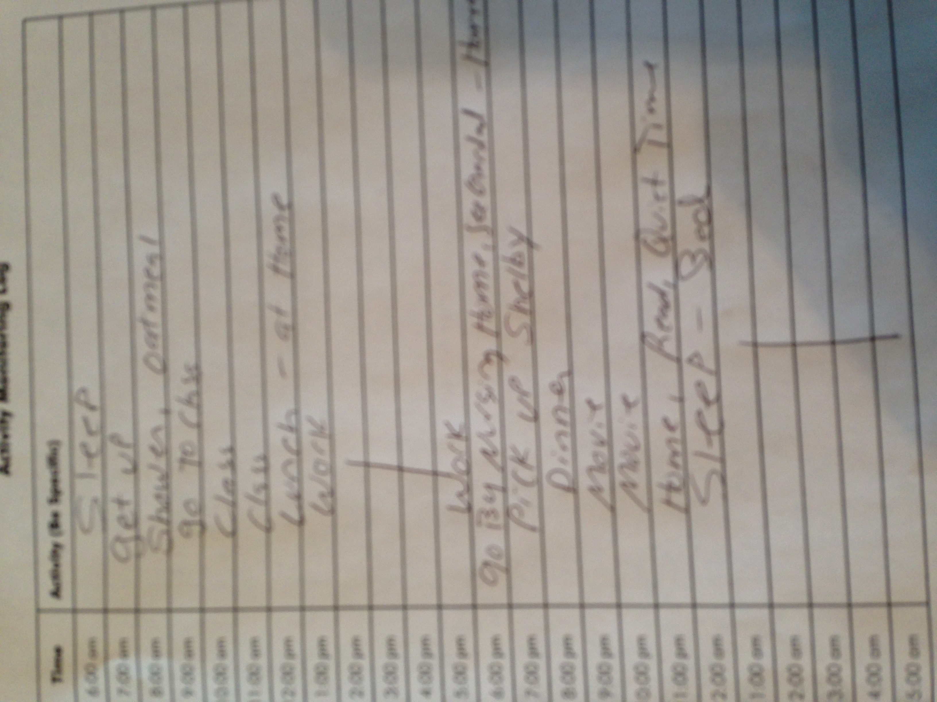
Activity Logs

Slide 8
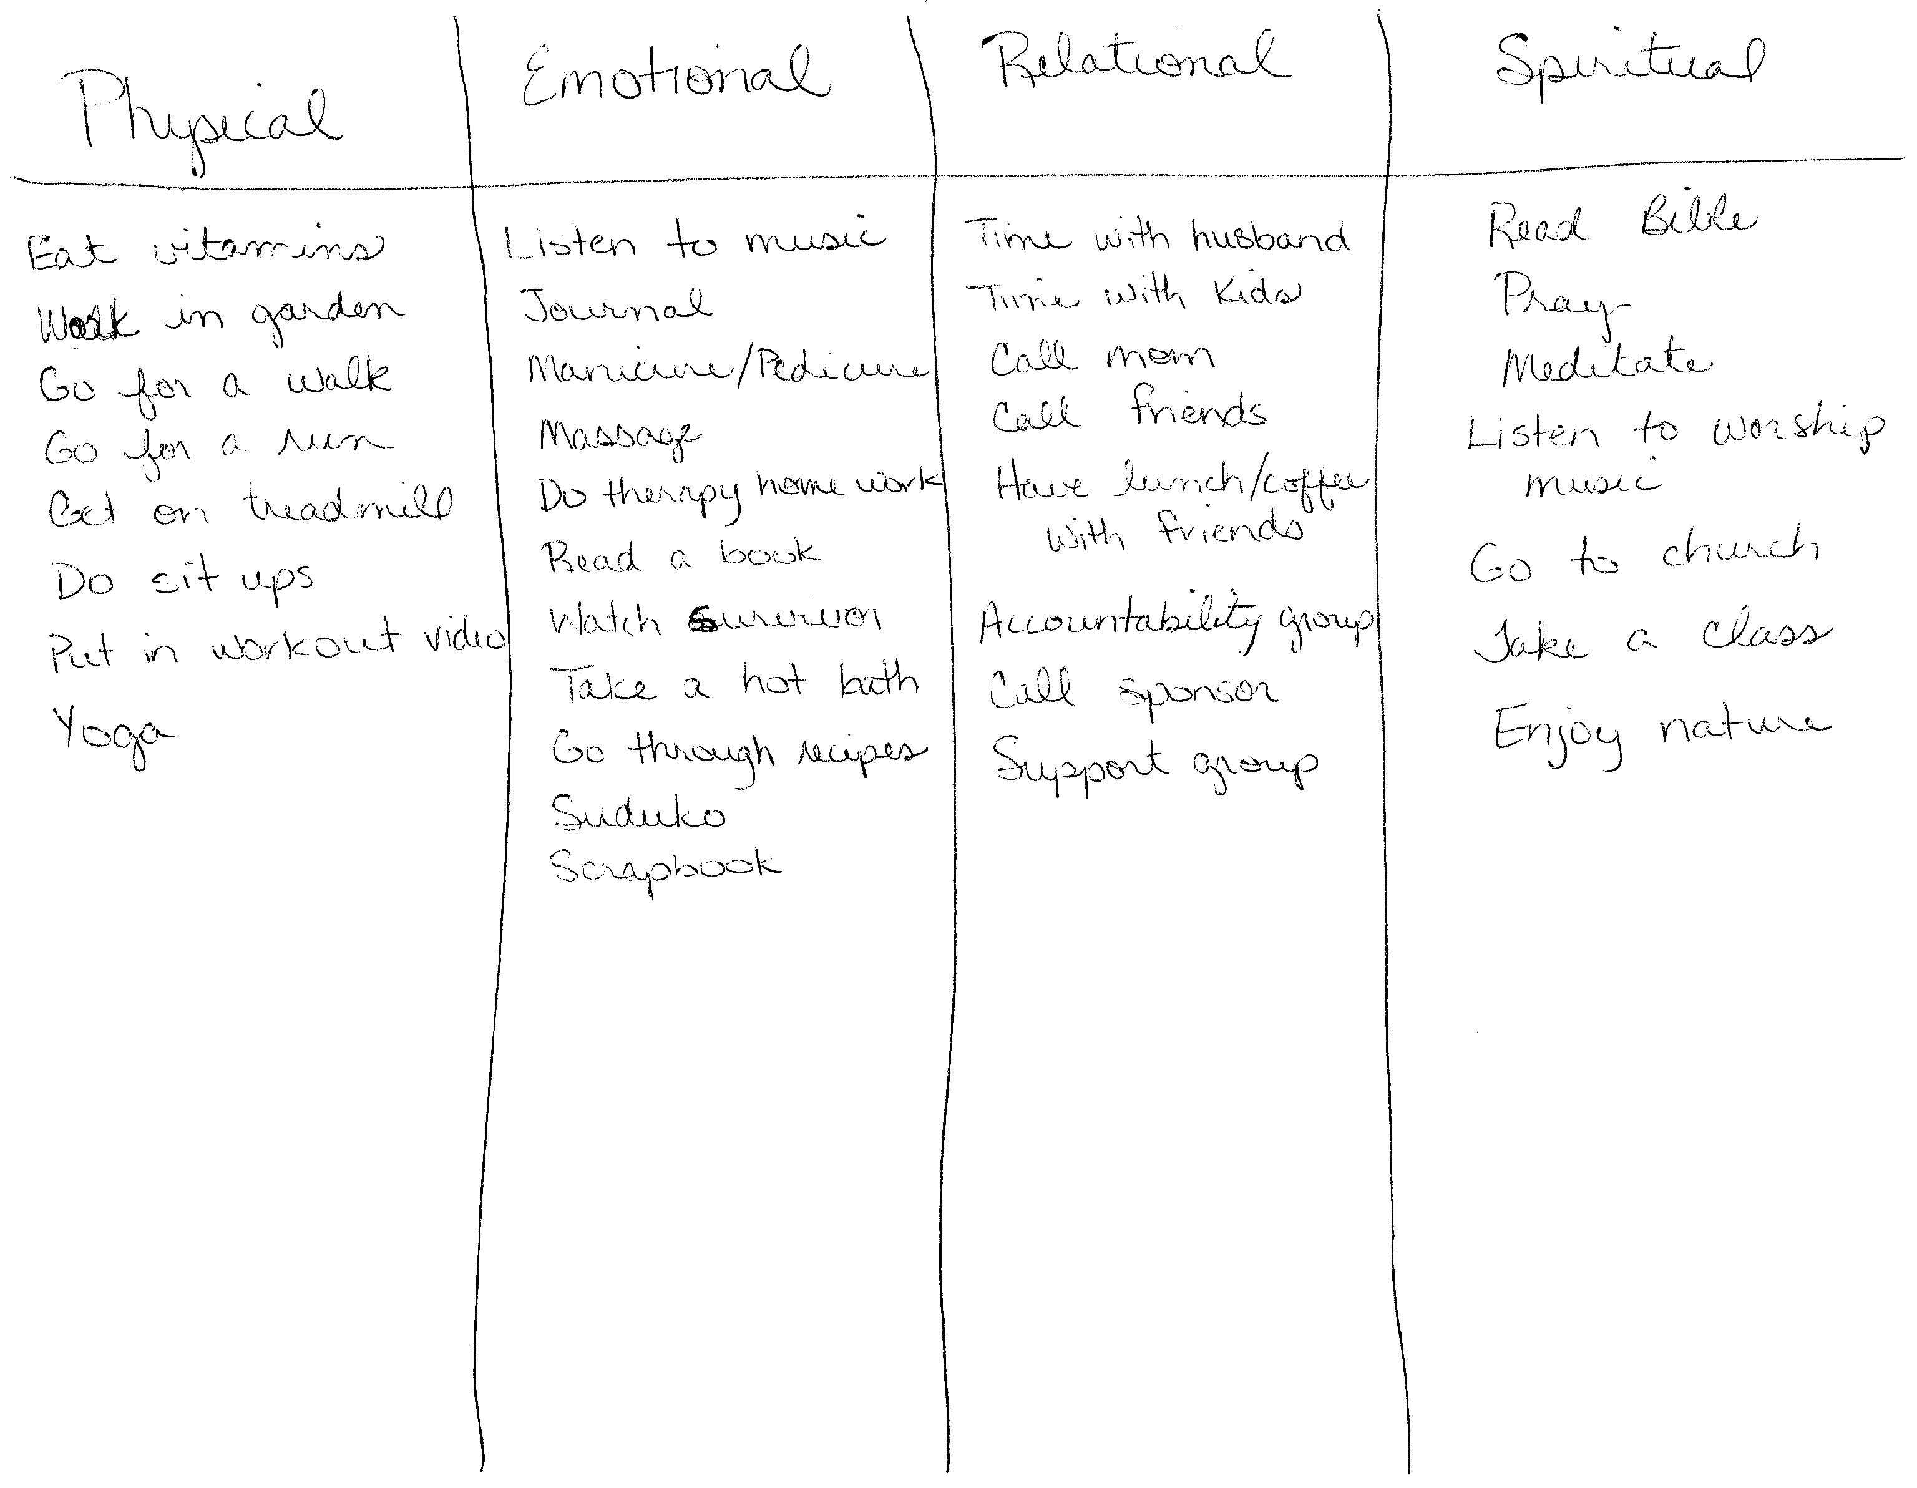
Self-Care

Slide 9
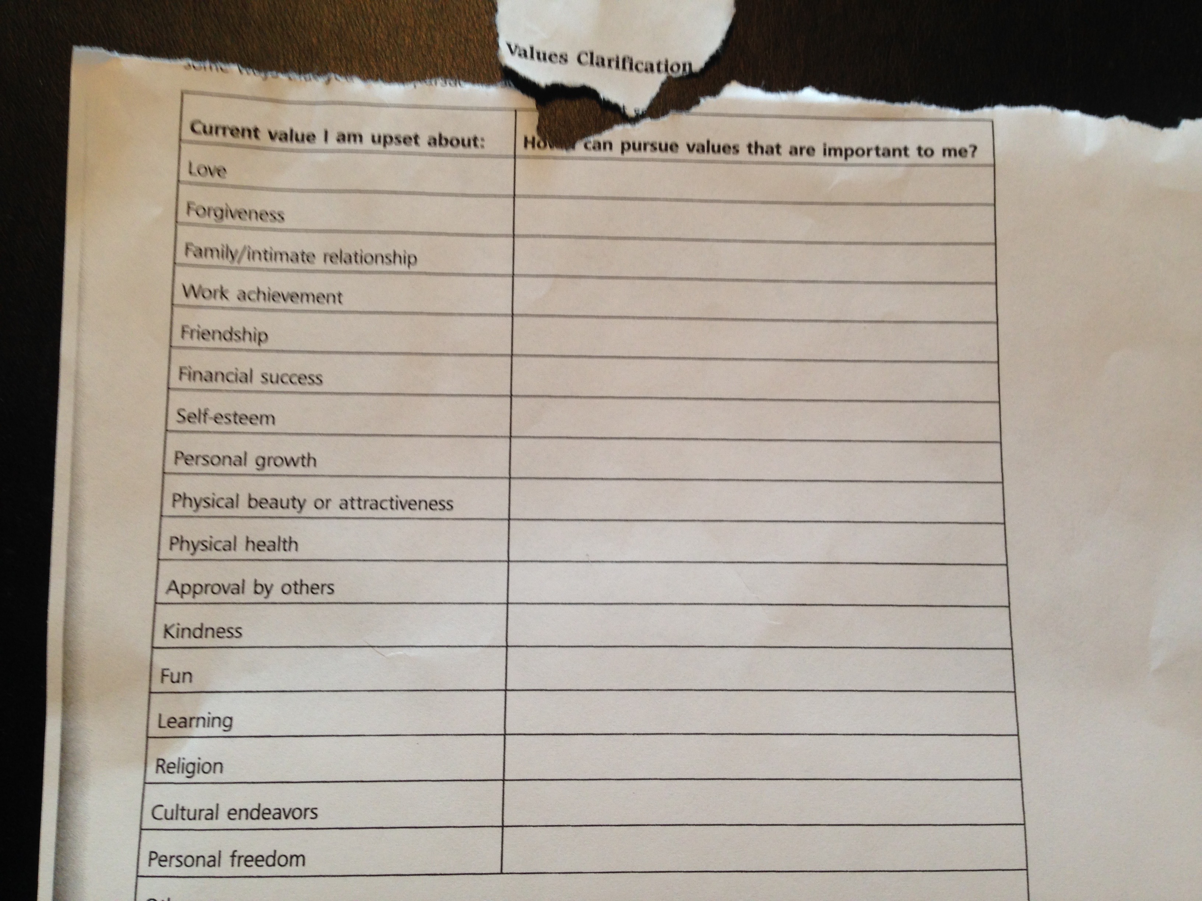
Depression – Examining My Values
Notes:
Selective abstraction
Mental filter

Slide 10
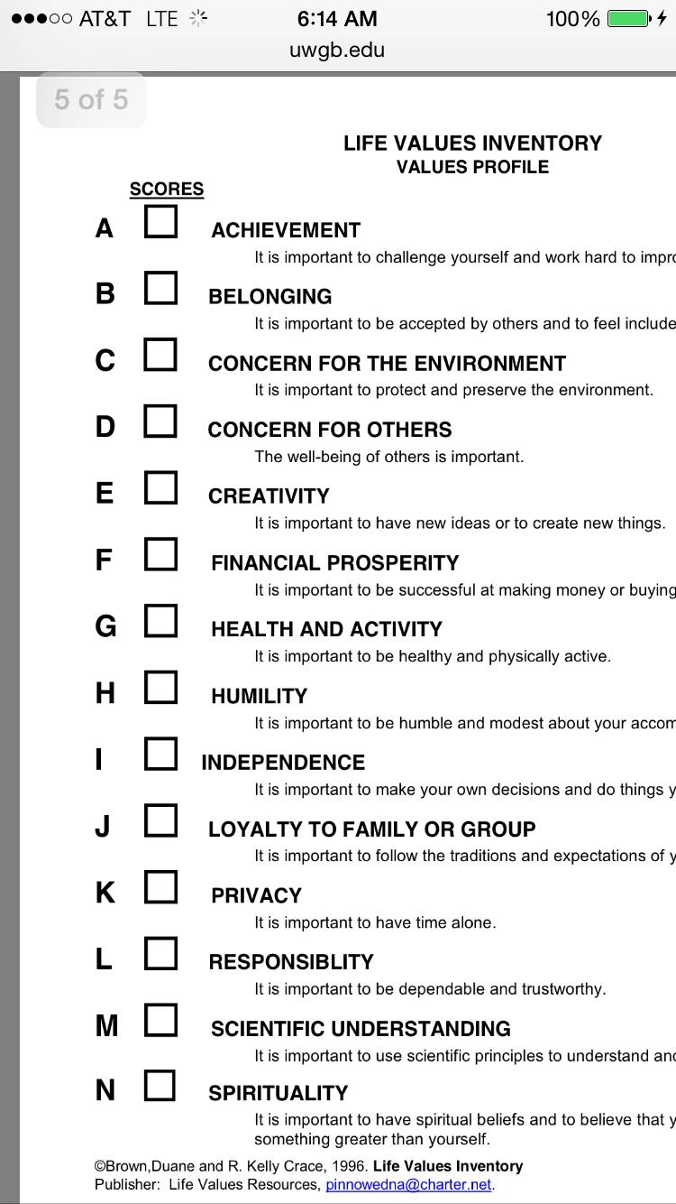
Life Values Inventory
Depressed Mood
Appetite/Sleep Disturbance
Cognitive Deficits
Anhedonia
Hopeless/Helpless
Suicidal Ideation
Notes:
Increased/Decreased
Concentration/memory, etc..
Loss of interest/drive

Slide 11
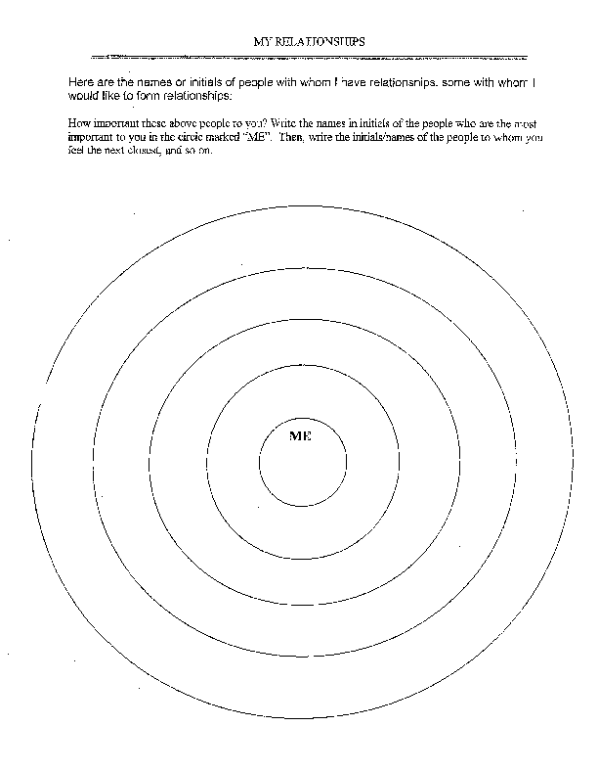

Slide 12
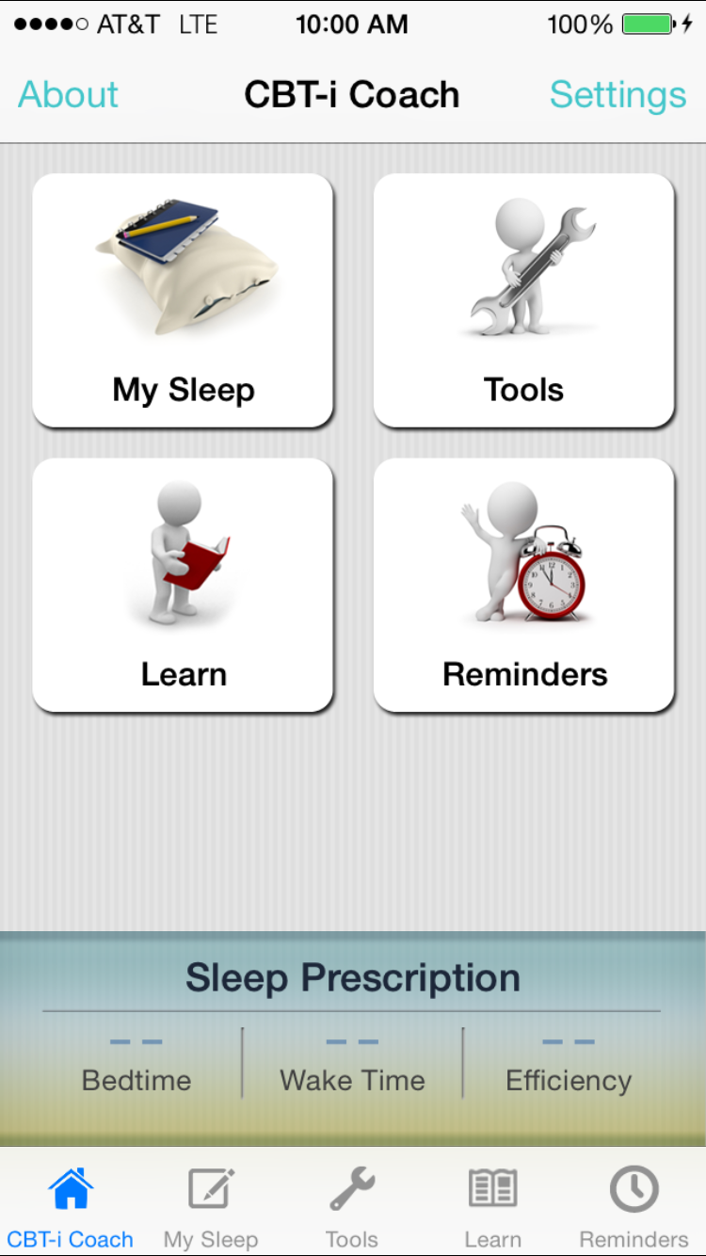
CBTi – CBT for Insomnia
Notes:
D/C Positive
Selective Abstraction
Hopeless/Helpless
List of Positives
Things Doing Right

Slide 13
Depression – Cognitive Strategies
Rainy Day Coping Narrative
Gratitude
Identify and Label Distortions
Rational Responses to Automatic Thoughts
Evaluate and Test Negative Assumptions
Notes:
D/C Positive
Selective Abstraction
Hopeless/Helpless
List of Positives
Things Doing Right

Slide 14
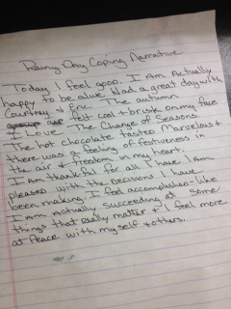
Depression – Tx Strategies Rainy Day Narrative

Slide 15
Depression – Gratitude List
Family
Friends
Housing
Senses
Health
Teachers
Happiness
Notes:
Selective abstraction
Mental filter

Slide 16
Depression – Gratitude List
God/Higher Power
Nature
Sun & Moon
Internet
Smart Phones
Pets
Movies
Notes:
Selective abstraction
Mental filter

Slide 17
Depression – Gratitude List
Job/Volunteer work
Shoes
Your bed
Husband/Wife
Laughter
Kind strangers
Living in US
Notes:
Selective abstraction
Mental filter

Slide 18
Belief Modification Protocol
Identify Maladaptive Belief
Identify Alternate Adaptive Belief
Rate Believability
Interventions
Rate Believability at Regular Intervals
Notes:
If intro course we would spend more time on these – negative views in these 3 areas
Basic
Develop Rapport
Socialize to Cognitive Model
Elicit specific thoughts
Examine evidence, etc

Slide 19
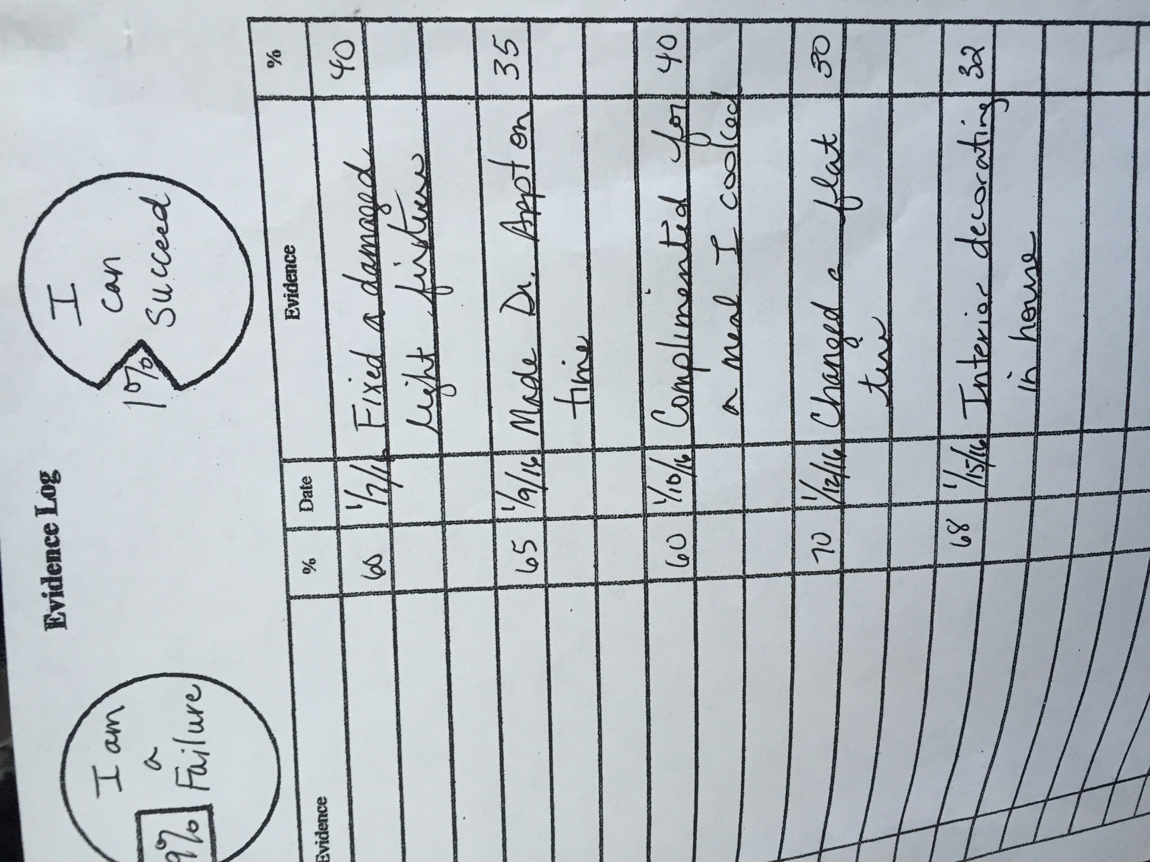
Depression – Schema Modification

Slide 20
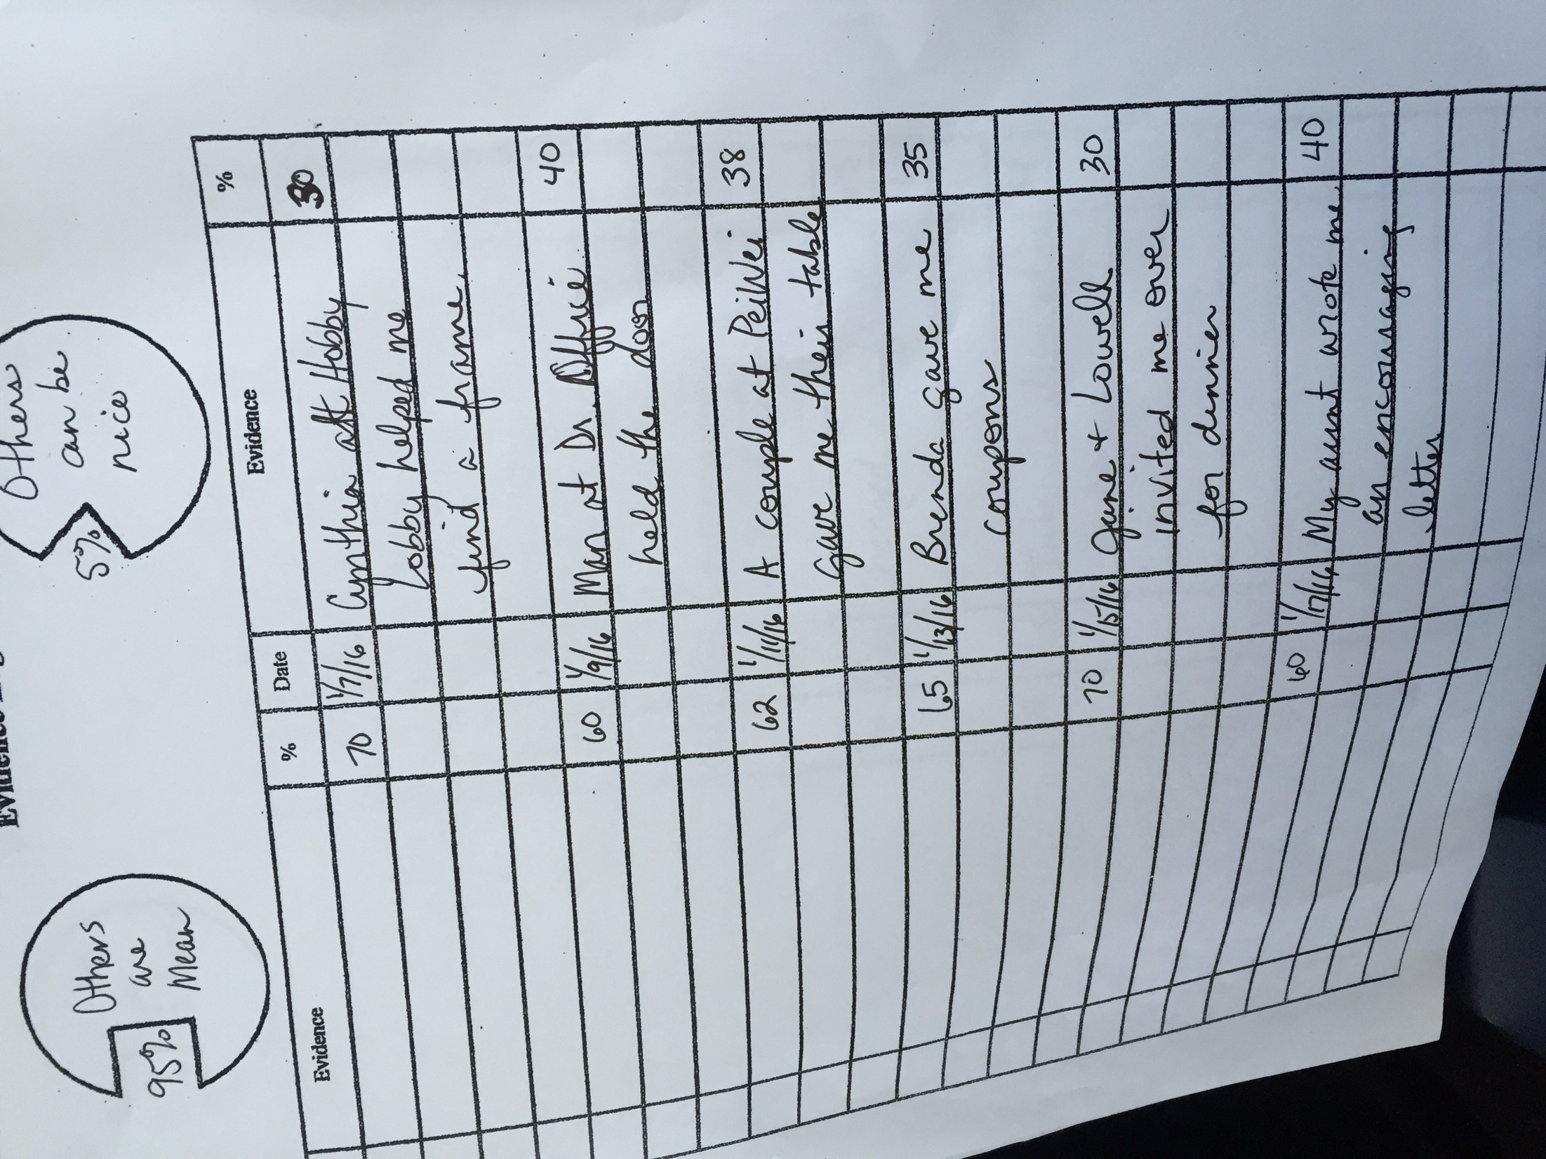
Depression – Schema Modification

Slide 21
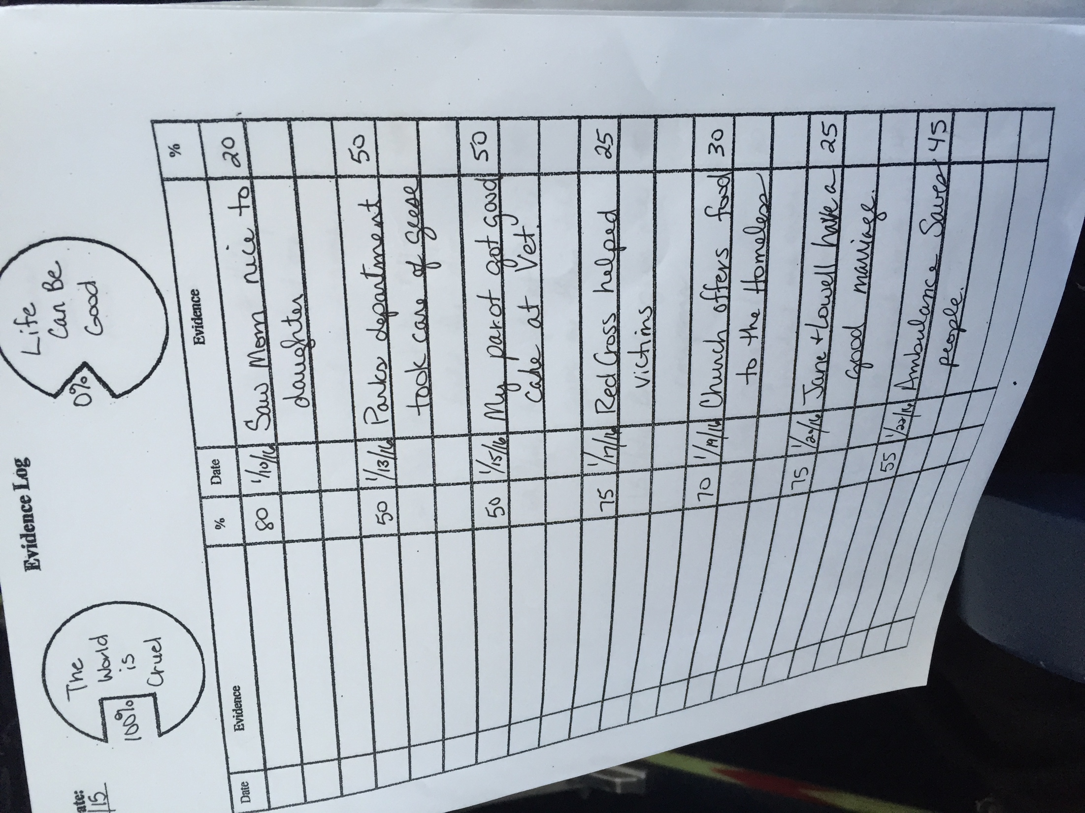
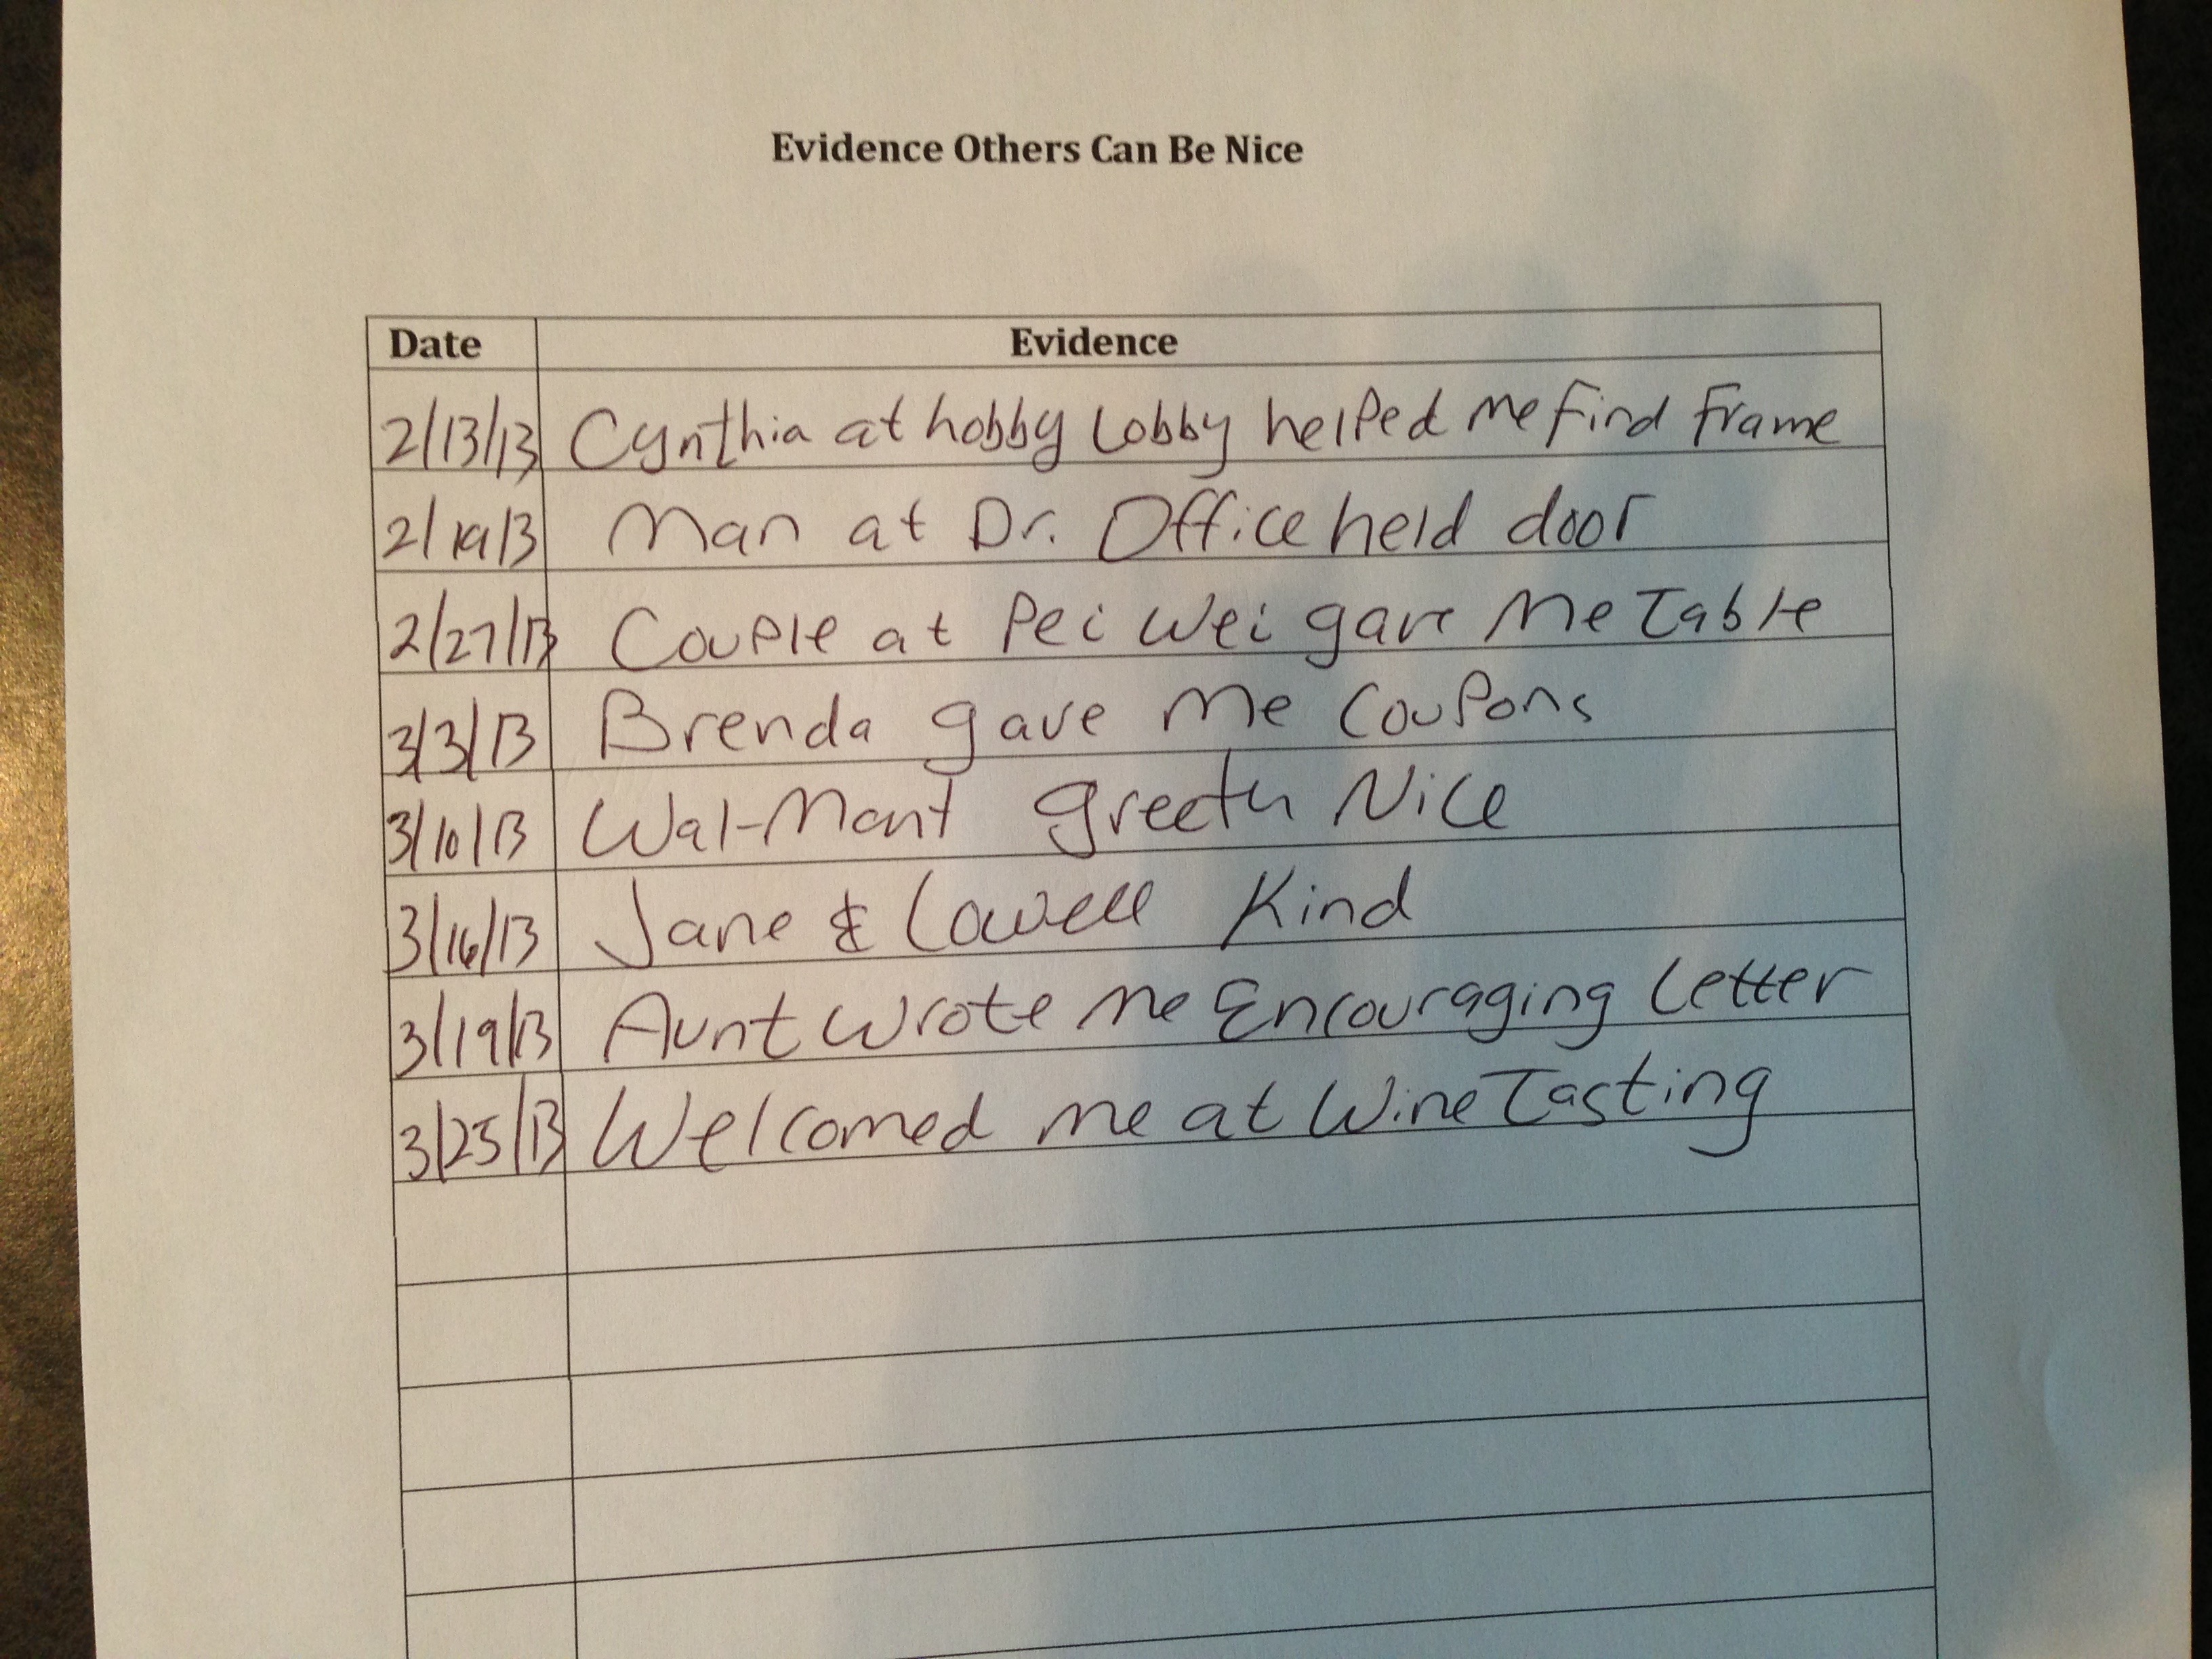
Depression – Schema Modification

Slide 22
Bipolar Disorder – Characteristics of Mania
Overly positive cognitions
Elevated Mood
Risk-Taking Behaviors
Notes:
Researchers have found that if you don’t go to bed until you are sleepy, you will go to bed quicker and sleep better quality
Bath b4 bed – an increase in body temperature makes some people get sleepy – get out of bed 20 min after trying and do a boring activitg, no naps, bedtime routine, monitor caffeine, sugar, etc
On a positive day when things are good, write about progress, affirmations, letter to self about recovery, etc.. – so will have it to pull out on day not so good – something very powerful about having something in your own writing
Schedule activities
Previuosly enjoyed/list of things might enjoy
Active – intent to release endorphins – exercise
Mastery (if conditional assumptions related to performance)
Interventions related to meaning/spirituality (return to church attendance, volunteer work, spiritual reading, etc)
Monitor Self-Talk - Depressed pts say things to themselves wouldn’t dream of saying to others – GOOd Q: Would I say this to someone else? If not, cant say it to me
Distortions usually involve selective abstraction, other variants of D/C positive

Slide 23
Bipolar Disorder –Mania Coping Skills
Medication
Mood Tracker
Exercise, other “energy burning” tasks
Self-Control Strategies
Limit Setting
Inoculate against manic distorted thinking
Notes:
Medication compliance
- 0-13
- pros and cons (top off at 9 but only bottom out at 3)
- Early warning signs/ contracting
- some less severe choose to not be on meds after pros and cons

Slide 24
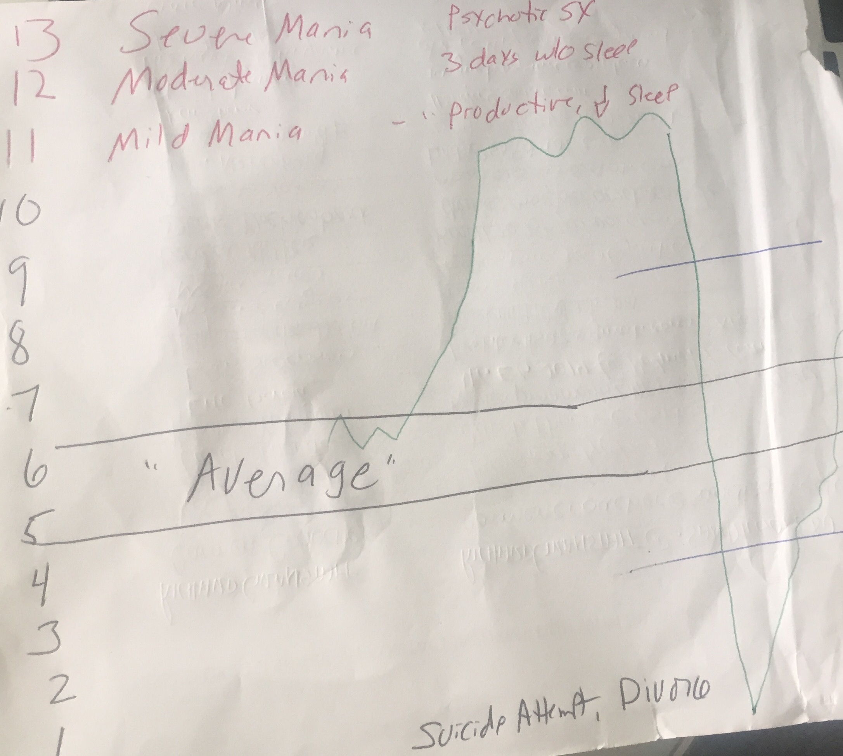
Bipolar Disorder –Mania Coping Skills
Notes:
Medication compliance
- 0-13
- pros and cons (top off at 9 but only bottom out at 3)
- Early warning signs/ contracting
- some less severe choose to not be on meds after pros and cons

Slide 25
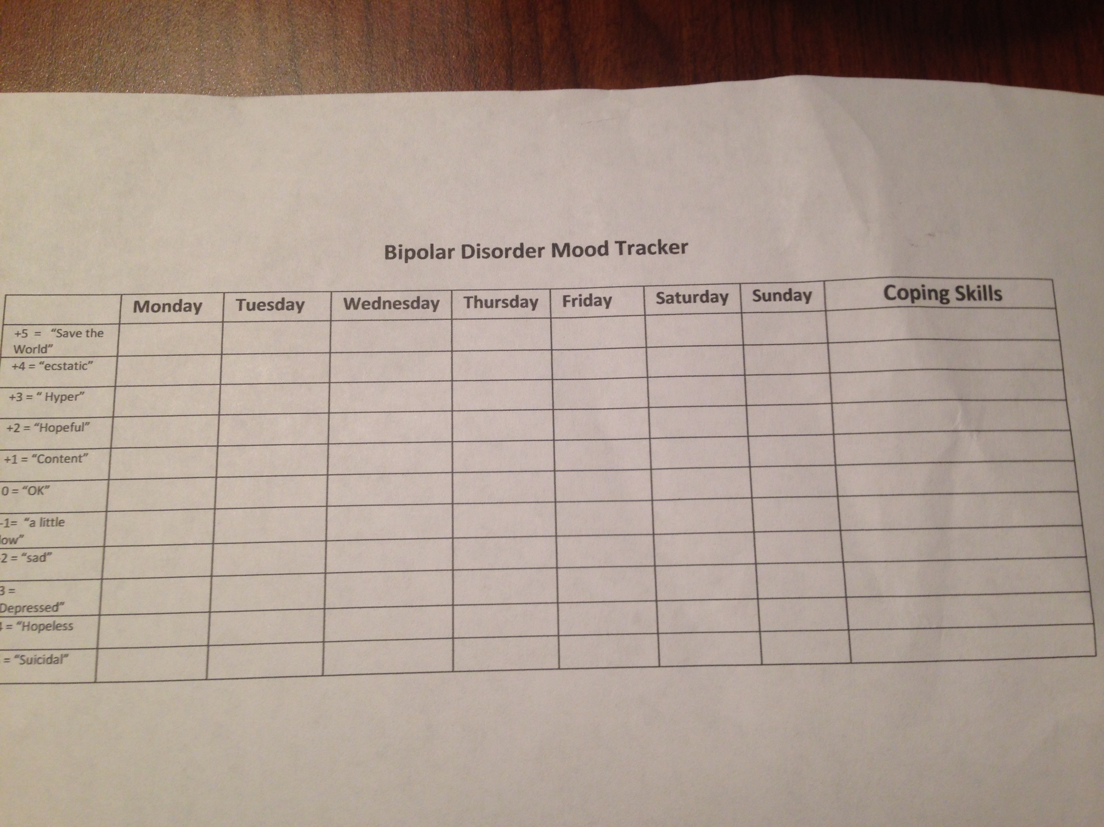
Bipolar Disorder – Coping Skills
Medication
Mood Tracker
Exercise, other “energy burning” tasks
Self-Control Strategies
Limit Setting
Inoculate against manic distorted thinking
Notes:
Researchers have found that if you don’t go to bed until you are sleepy, you will go to bed quicker and sleep better quality
Bath b4 bed – an increase in body temperature makes some people get sleepy – get out of bed 20 min after trying and do a boring activitg, no naps, bedtime routine, monitor caffeine, sugar, etc
On a positive day when things are good, write about progress, affirmations, letter to self about recovery, etc.. – so will have it to pull out on day not so good – something very powerful about having something in your own writing
Schedule activities
Previuosly enjoyed/list of things might enjoy
Active – intent to release endorphins – exercise
Mastery (if conditional assumptions related to performance)
Interventions related to meaning/spirituality (return to church attendance, volunteer work, spiritual reading, etc)
Monitor Self-Talk - Depressed pts say things to themselves wouldn’t dream of saying to others – GOOd Q: Would I say this to someone else? If not, cant say it to me
Distortions usually involve selective abstraction, other variants of D/C positive

Slide 26
Depression Coping Skills
See Depression Strategies
Notes:
Researchers have found that if you don’t go to bed until you are sleepy, you will go to bed quicker and sleep better quality
Bath b4 bed – an increase in body temperature makes some people get sleepy – get out of bed 20 min after trying and do a boring activitg, no naps, bedtime routine, monitor caffeine, sugar, etc
On a positive day when things are good, write about progress, affirmations, letter to self about recovery, etc.. – so will have it to pull out on day not so good – something very powerful about having something in your own writing
Schedule activities
Previuosly enjoyed/list of things might enjoy
Active – intent to release endorphins – exercise
Mastery (if conditional assumptions related to performance)
Interventions related to meaning/spirituality (return to church attendance, volunteer work, spiritual reading, etc)
Monitor Self-Talk - Depressed pts say things to themselves wouldn’t dream of saying to others – GOOd Q: Would I say this to someone else? If not, cant say it to me
Distortions usually involve selective abstraction, other variants of D/C positive

Slide 27
Depression Research
See Depression Strategies
Notes:
Researchers have found that if you don’t go to bed until you are sleepy, you will go to bed quicker and sleep better quality
Bath b4 bed – an increase in body temperature makes some people get sleepy – get out of bed 20 min after trying and do a boring activitg, no naps, bedtime routine, monitor caffeine, sugar, etc
On a positive day when things are good, write about progress, affirmations, letter to self about recovery, etc.. – so will have it to pull out on day not so good – something very powerful about having something in your own writing
Schedule activities
Previuosly enjoyed/list of things might enjoy
Active – intent to release endorphins – exercise
Mastery (if conditional assumptions related to performance)
Interventions related to meaning/spirituality (return to church attendance, volunteer work, spiritual reading, etc)
Monitor Self-Talk - Depressed pts say things to themselves wouldn’t dream of saying to others – GOOd Q: Would I say this to someone else? If not, cant say it to me
Distortions usually involve selective abstraction, other variants of D/C positive

Slide 28
CBT Webinar: Week 4
The Cognitive Model of Anxiety
Notes:
Brainstorm “what kinds of things are we looking for in terms of childhood data?

Slide 29
Cognitive Model Of Anxiety
Risk
Anxiety = ________
Resources
Notes:
Clinical implications:
3 General Treatment Considerations
Recognition of resources already at disposal
Increase resources
Develop a more realistic view of the risks

Slide 30
Anxiety - Primary Distortions
Mind-Reading
Fortune-Telling
Magnification
Notes:
jhgjkgh

Slide 31
Anxiety - Primary Schemas
Helpless
Abandonment
Unlovable
Vulnerability
- Relational
- Financial
- Physical Body
Notes:
jhgjkgh

Slide 32
Anxiety – Clinical Manifestations
Triggers
Cognitive processes & Bias
Avoidance
Physical Sx
Compulsive and safety Behaviors
Skills deficits (or perceptions)
Environmental/family factors

Slide 33
CBT for GAD
Verbal Cognitive Strategies
Behavioral experiments
Journaling
Deep Breathing exercises
Metacognitive Strategies

Slide 34
GAD – Metacognitive Strategies
Positive Metacognive Beliefs
Worrying helps me cope
If I worry, Ill be more prepared
Worrying helps me stay in control
If I worry, I can anticipate problems

Slide 35
GAD – Metacognitive Strategies
Negative Metacognive Beliefs (uncontrollability)
I have no control over my worry
Worry has taken over my life
I have lost control of my thoughts

Slide 36
GAD – Metacognitive Strategies
Negative Metacognive Beliefs - Danger
“Worry will make me lose my mind”
“Worry will make me have a breakdown”
“Worry will cause a heart attack”

Slide 37
GAD – Unhelpful Strategies for Dealing with Worry
Thought Stopping
Avoidance
Alcohol, MJ
Workaholism
Other Distraction
Reassuranse Seeking Behaviors

Slide 38
GAD – Strategies for Dealing with Worry
Mindfulness/Acceptance (vs “I have to quit thinking about this”
Tolerating Uncertainty (vs trying to prove it won't happen)
View thoughts as “Static”
Schedule “Worry Time”

Slide 39
CBT for Phobias
Imaginal
In-Vivo
Hierarchies
Behavioral Experiments
https://www.youtube.com/watch?v=jRFfDps3_6M
Notes:
Bridge

Slide 40
Behavioral Experiments
Identify Assumption w/ specific predicted Outcome
Collaboratively ID task that will test assumption
Experiment must have clear bearing on validity
Review Findings

Slide 41
CBT for Panic Disorder
Trigger is anxiety vs environmental
Restructure Misinterpretation of sx
Interoceptive Strategies
Empirically supported protocal: Clark, Barlow
Notes:
Fighting fear is counter productive
Sweaty palms - -didn’t notice until forced self to – they are looking for it “something terrible will happen to my body”
Interpret sweat as sign of rectal cancer – wipe excessively, create blood, misinterpret blood

Slide 42
CBT for Social Anxiety
Trigger is People
Unlovable schema work
Continuum Work
spouse neighbors dog
I------------------------------------I
Challenge people pleasing cognitions
Polling exercises

Slide 43
Notes:
Big unlovable belief – “the way I see it, we have 2 possibilities – either you are correct and you are unlikable and we can work to make you more likable, or you are NOT unlikable and we can try to help you see yourself more like others see you

Slide 44
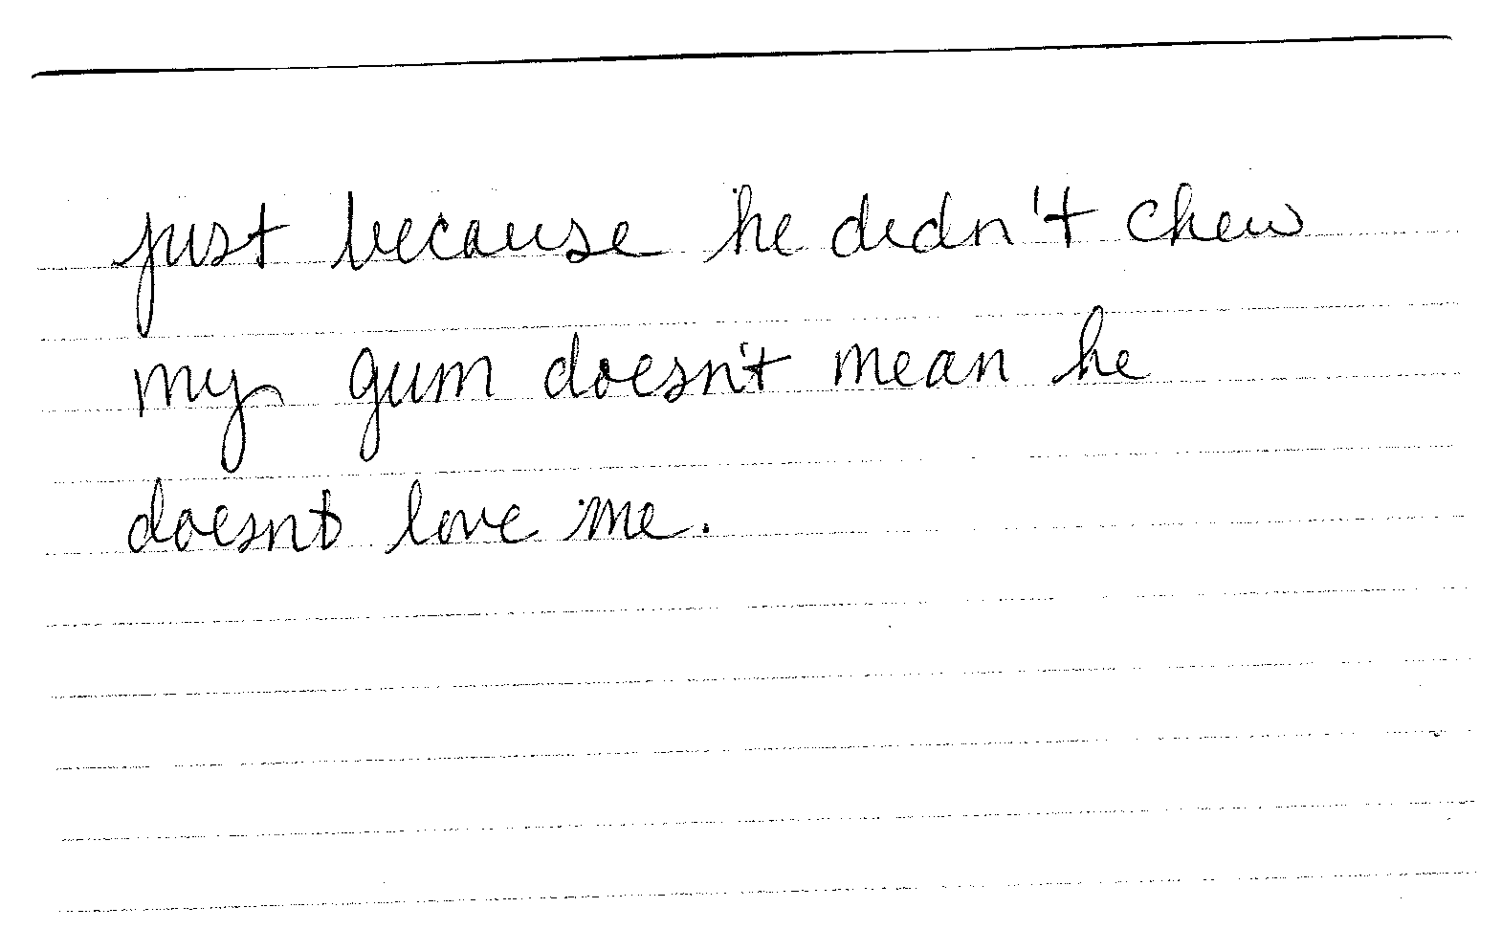

Slide 45
CBT for Anxiety/Perfectionism
(Antony, 2013)
Functional vs Dysfunctional Perfectionism
- Are my standards higher than others?
- How often am I able to meet my standards?
- Do I expect others to meet those standards?
- Do my standards help me meet my goals or get in the way?

Slide 46
CBT for Anxiety/Perfectionism
Perfectionism is associated with a number of other psychological problems
Social Anxiety
OCD
Depression
Eating Disorders
Anger

Slide 47
CBT for Anxiety/Perfectionism
Domains Effected
Work or School Performance
Romantic Relationships
Friendships
Organization
Communication Skills
Health (strict rules on diet or exercise)

Slide 48
CBT for Anxiety/Perfectionism
Behavioral Manifestations
- Rehearsing/Memorizing
- Overpreparing
- Trying to change the behavior of others
- Procrastinate
- Not know when to quit
- Inability to Delegate

Slide 49
CBT for Anxiety/Perfectionism
Change Strategies
- Exposure
- Examine the Evidence
- Do the thing you are afraid of
- Prevent Safety Behaviors
- Prioritize (big from the small)
- Learn to Compromise

Slide 50
Anxiety Disorders – Cognitive Strategies
Verbal Cognitive Strategies
Evaluate/Test Fortune-Telling, Mind Reading, Magnification Cognitions
Pre, Post Cognitive Work
Schema-Based Journaling
Cognitive Cue Cards
Notes:
Verbal Cognitive Strategies – well established in Panic DO, Social phobia, GAD, PTSD – more recent but less support for OCD
Pre-Post cog work
Frequency – the longer between sessions, longer cognitive change occurred in session has opportunity to shift back
Fighting fear in unproductive – lying in bed “I have to sleep I have to sleep”

Slide 51
General Strategies for Dealing With Anxiety
Exercise
Yoga
Limit Caffeine, Sugar
Journaling

